Slide 1
Games Bootcamp
C# Scripting

Slide 2
Recap
UI Principles & Scripting Basics

Slide 3
01
Core Concepts C#

Slide 4
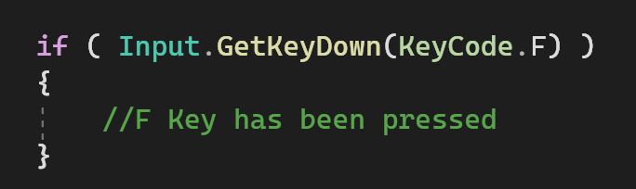
Conditional Statements (1)
Control the program flow based on true or false conditions
Condition
Block

Slide 5
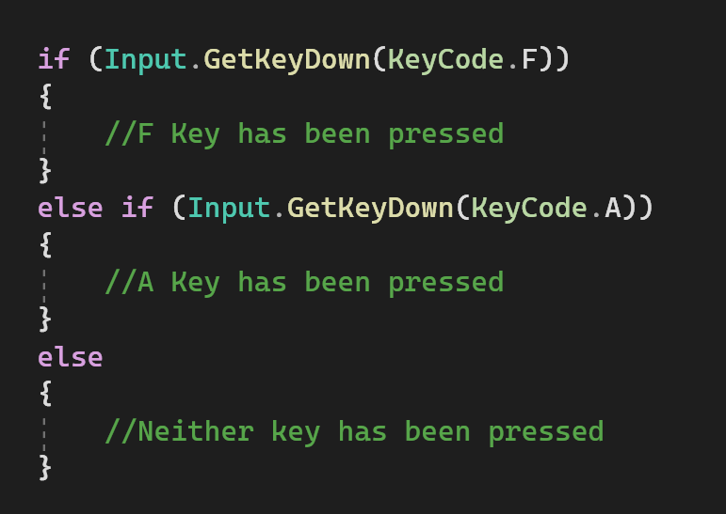
Conditional Statements (2)
Three keywords
‘Else’ does not have a condition
Order of execution is top to bottom
Execution stops when condition is true.

Slide 6

Conditional Statements (3)
Conditional operants help combine statements into one true/false
Logical Operators
Relational Operators
<, >, <=, >=, ==, !=
‘ == ‘ is not the same as ‘ = ‘

Slide 7
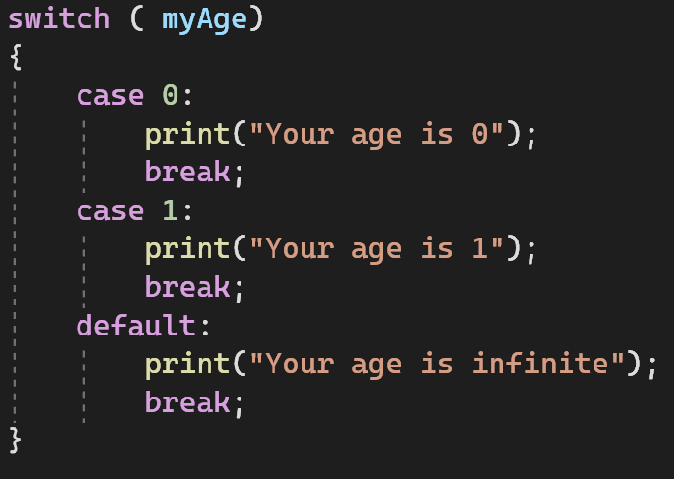
Conditional Statements (4)
Switch statements are used when is more than a true or false outcome.
Must be an integral type
Each case must have a ‘break’ at the end.
The ‘default’ condition runs if no other case is true.
THIS IS A BAD EXAMPLE!

Slide 8
Conditional Statements (5)
Define a win and lose condition for our Roller-Ball game.
Write a conditional statement that checks if the win or lose condition has been met.
Print a message to the console informing us that the condition has been met.

Slide 9
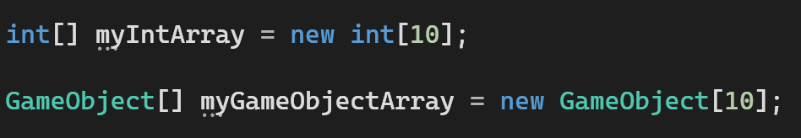
Containers (1)
Structures used to store and organise multiple pieces of data

Slide 10
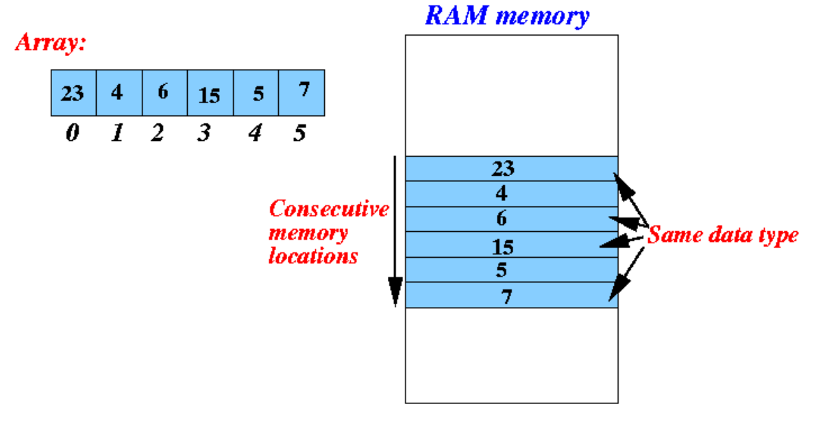


Containers (2)
Declaring an array pre-allocates space in memory.

Slide 11
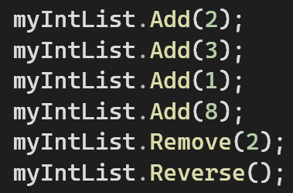
Containers (3)
Lists are dynamic arrays.
Lists have useful functions

Slide 12

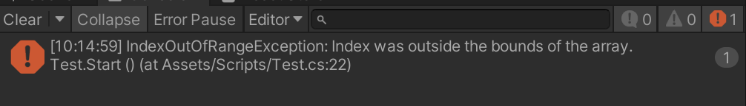
Containers (4)
Lists are also indexed like an Array
Both containers will through this error.

Slide 13
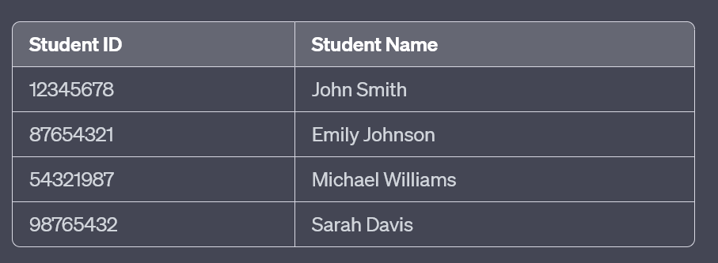
Containers (5)
Dictionaries are a key-value container.

Slide 14


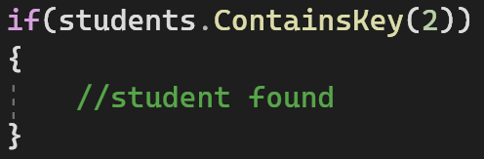
Containers (6)
Keys are unique, values are not.
You access elements through ‘Key’ not and index
Useful functions.

Slide 15
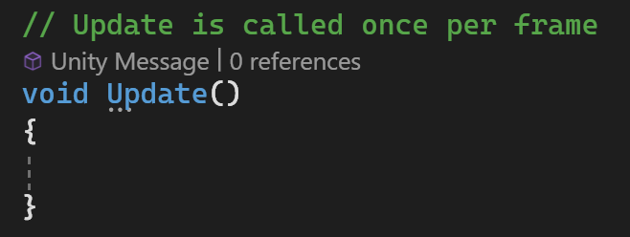
Functions In Depth (1)
Reusable blocks of code that perform a specific task

Slide 16
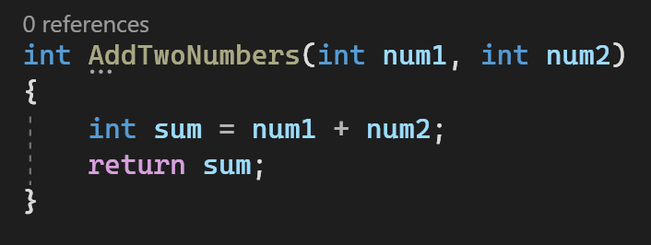
Functions In Depth (2)
Parameters
Return Type
return value

Slide 17
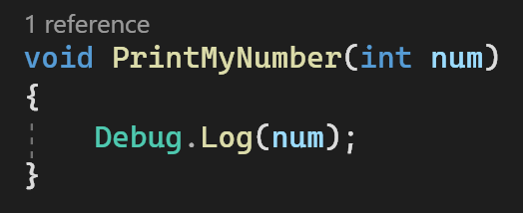
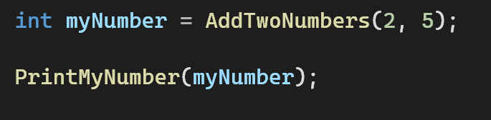
Functions In Depth (3)
Functions are called my using the name and passing in the values you want.
If the function has void return type then it cannot be assigned to a value.

Slide 18
Functions

Slide 19
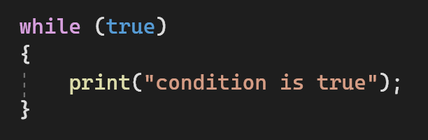
Loops (1)
Code that repeats a block of code as long as the condition is true.

Slide 20



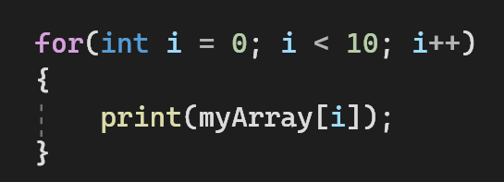
Loops (2)
Loops are very useful for iterating through containers

Slide 21
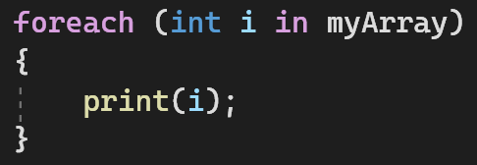


Loops (3)
C# has a more readable version
Make sure you understand the standard version first
Loops can be written to run through the container in reverse order.
BE AWARE OF THE SIZE OF THE CONTAINER

Slide 22
Loops
Write a new script that will print mean, median, and range.

Slide 23
02
Practical Tasks

Slide 24
Thanks!

